Slide 1




This listening project was designed to hear from young people around their knowledge, interest and participation in health and care research
10 groups from Mid/ South areas of Essex took part in the project.
5 of the groups had protected characteristics and 5 were open access groups
We were also able to establish from young people which issues around healthcare are important to them, what the barriers are to their participation and how we could go about involving more young people in health and care research in the future
Notes:
Who are ECVYS? (been around for over 50yrs representing the vol youth sector in Essex. Membership reach of over 270,000 children and young people)
What is a listening project and who have funded projects before? (listening to young people in trusted environments where they can be honest with leaders. Can take place anywhere youth work happens i.e clubs, sports, detached youth work on the streets etc. Who funded? PFCC, VVU, Internet watch foundation, Anglia Ruskin, National institute of health research (eastern region), Essex community foundation and more!)

Slide 2
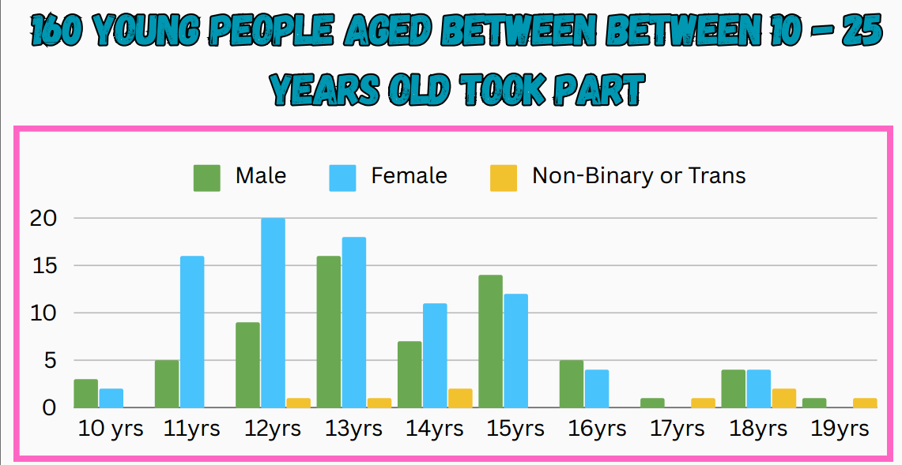

Slide 3
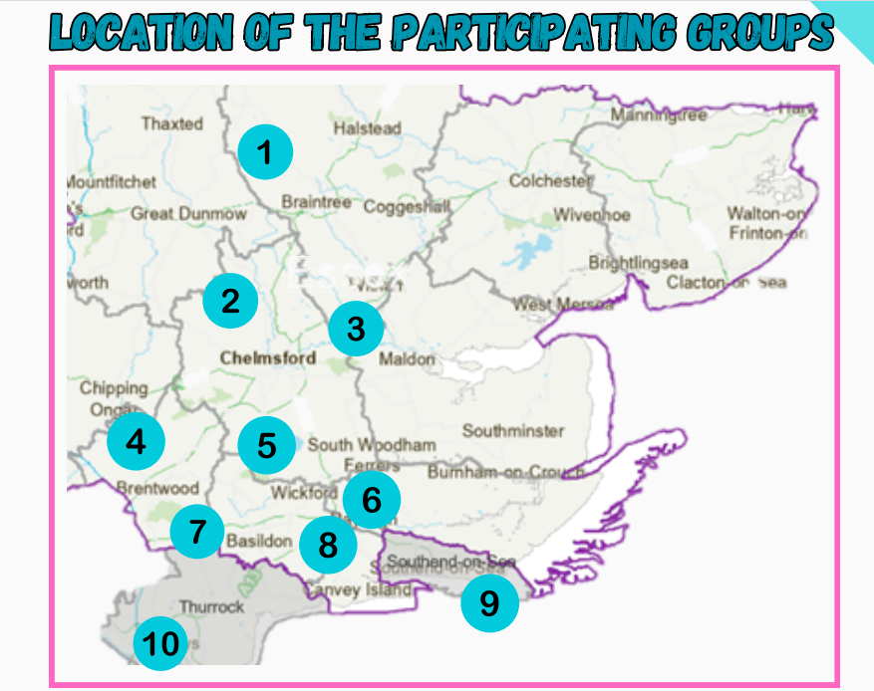
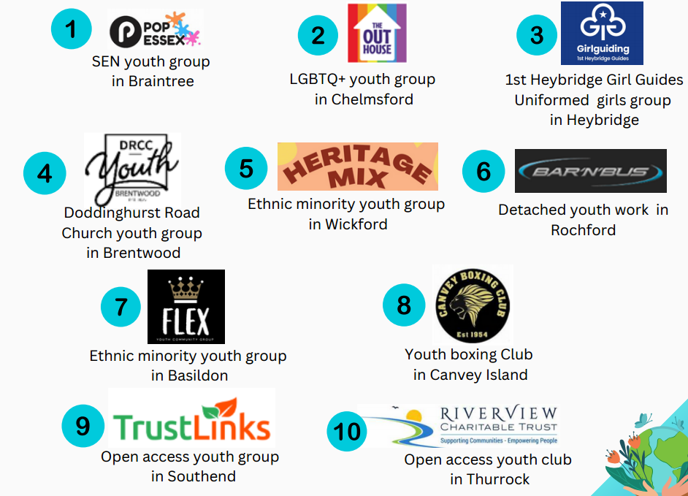

Slide 4
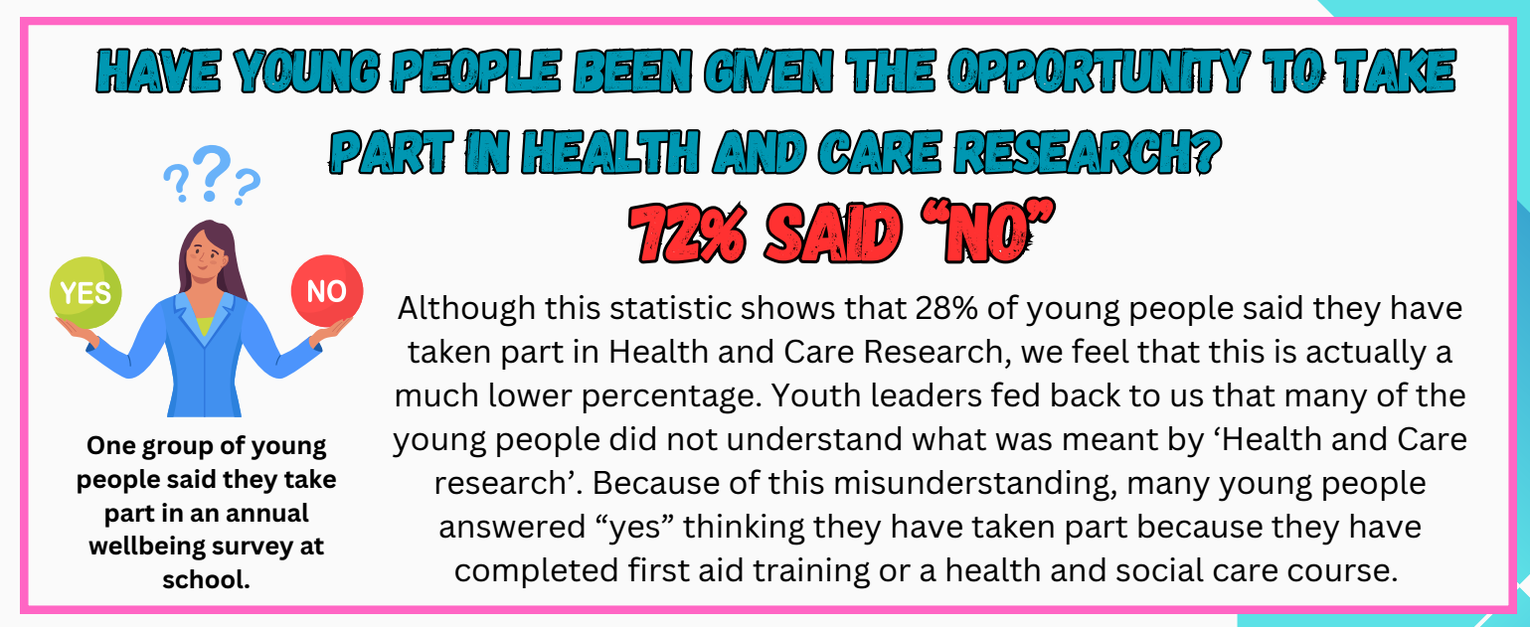
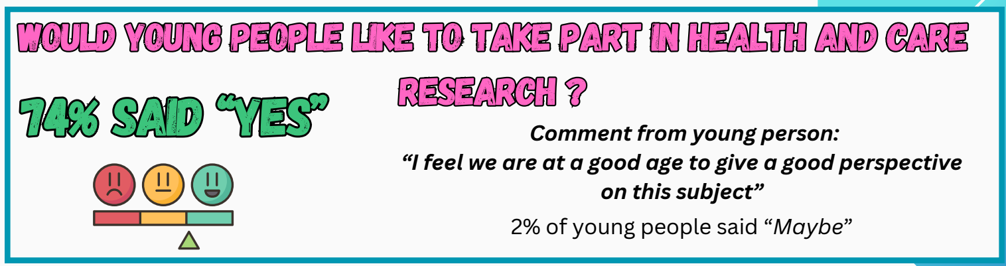

Slide 5
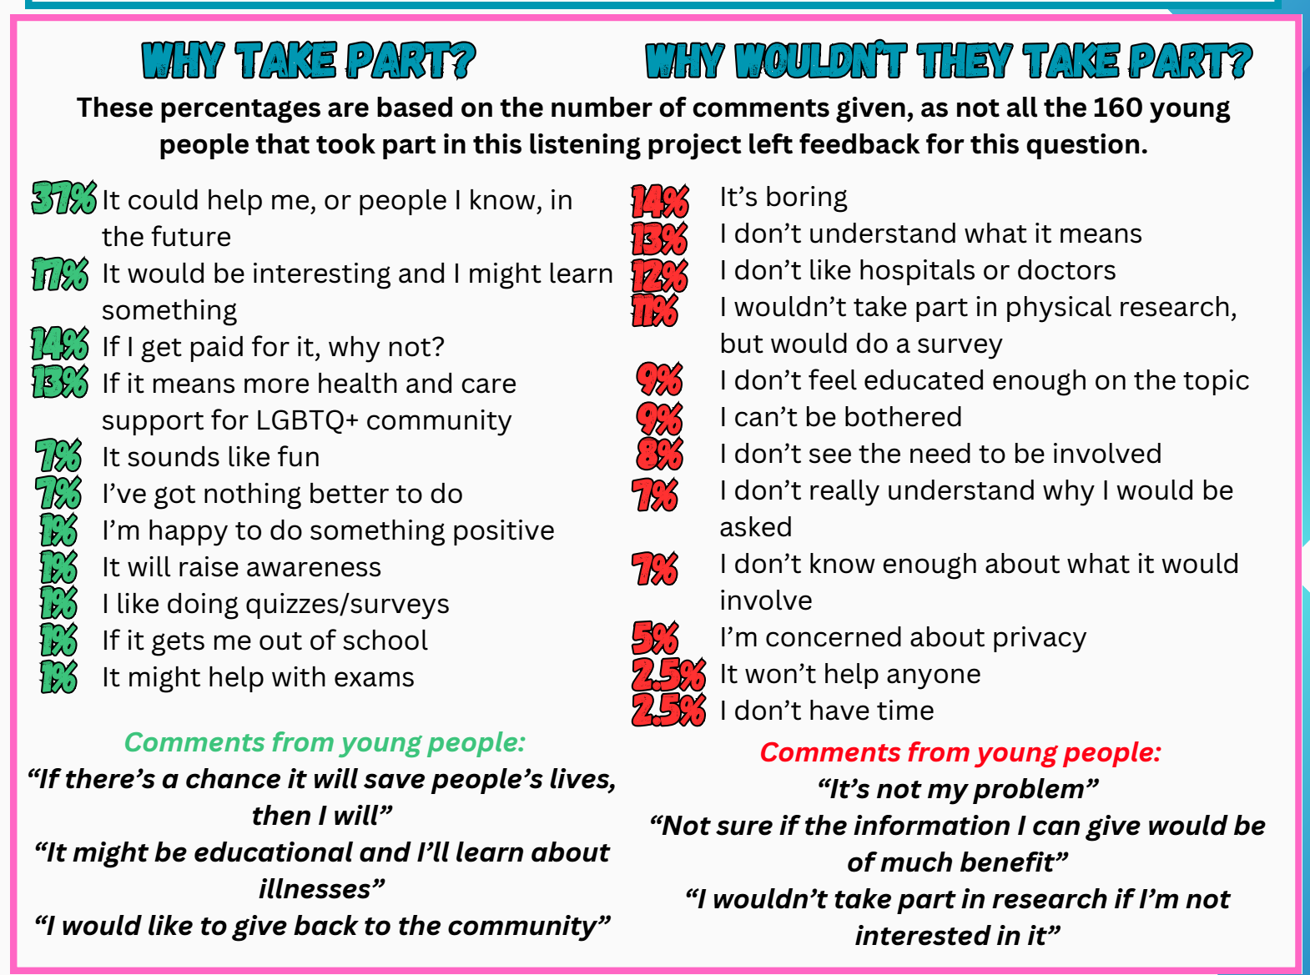
Notes:
Not all the young people answered this question and so the percentages are based upon those that did.

Slide 6

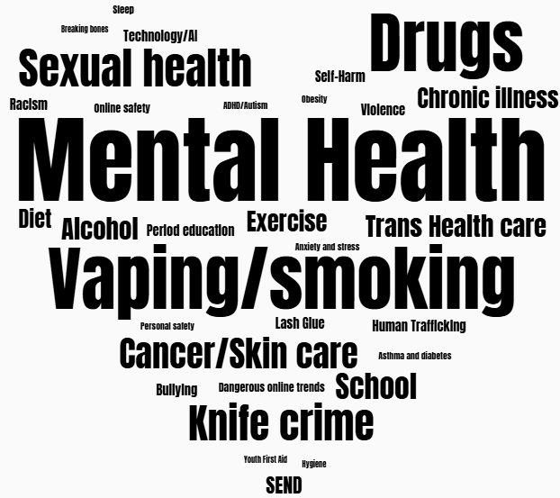

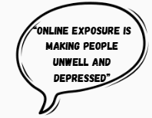

‘Mental Health’ was the most popular response.
Many young people talked about the overwhelming pressure and expectations at School and asked for more support in educational settings.

Slide 7
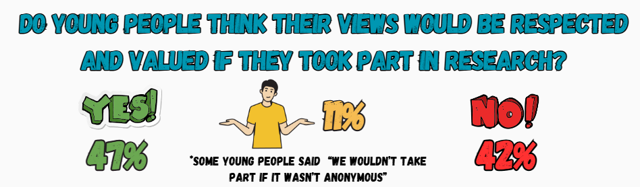
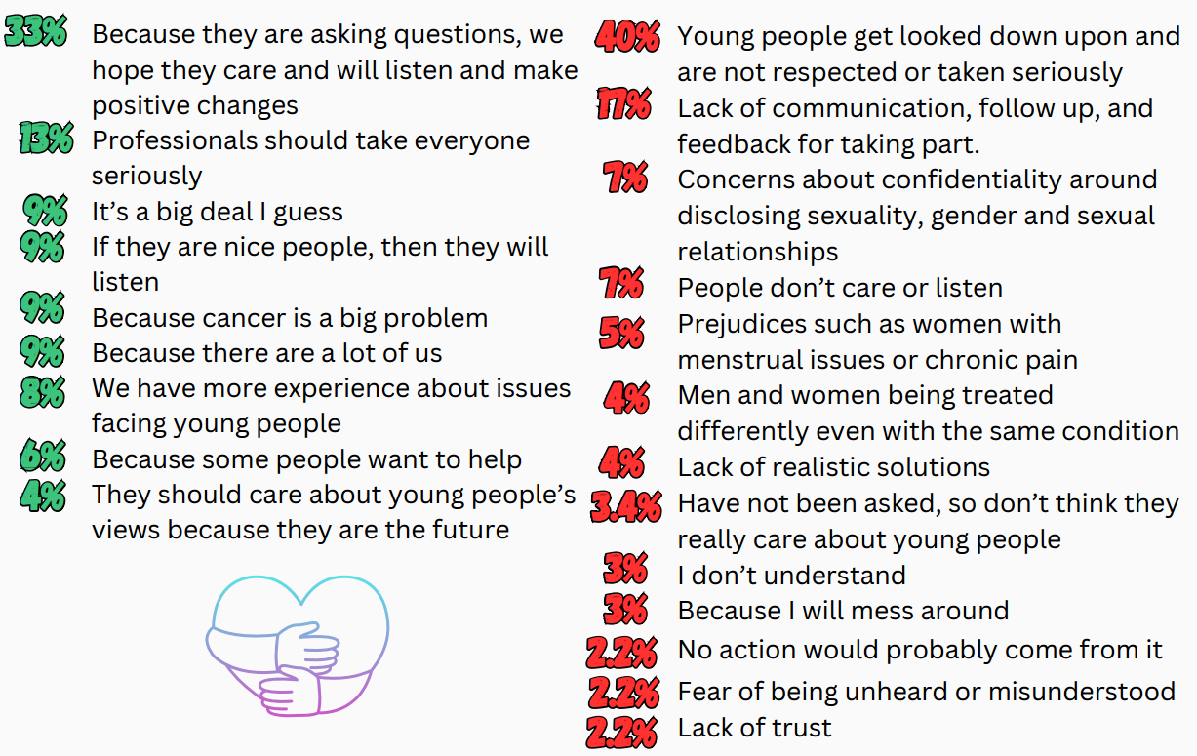
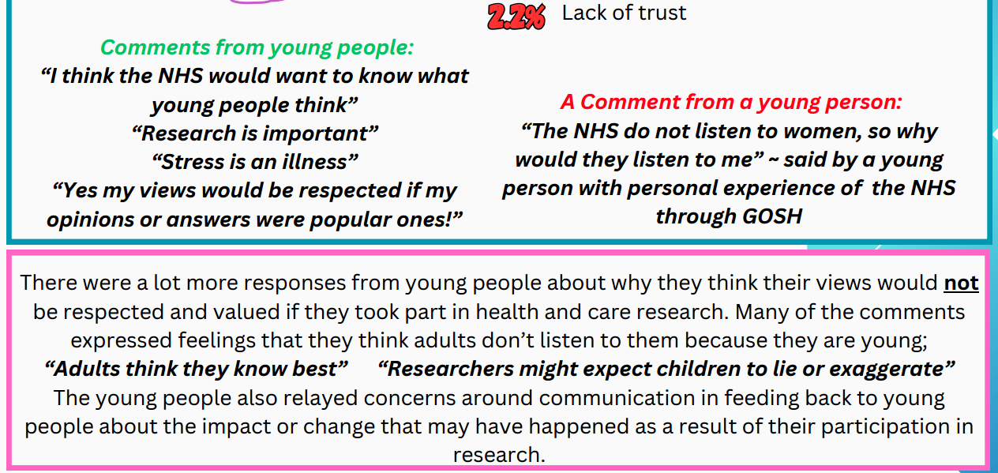

Slide 10
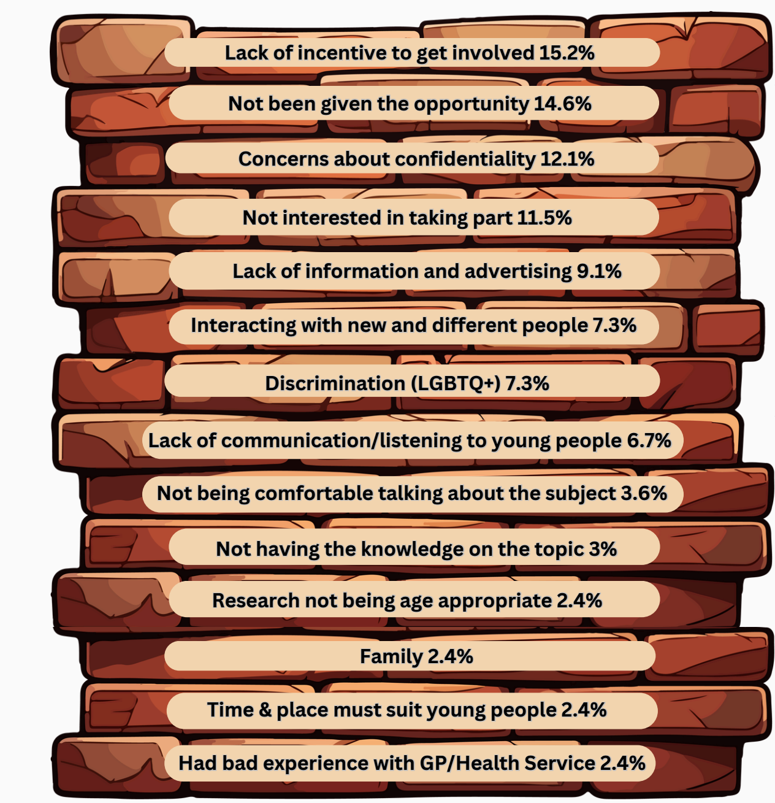



‘Lack of Incentive’ and ‘lack of opportunities to take part’ are the biggest barriers.
Many young people also commented about concerns around confidentiality,
with comments like
‘I feel afraid to speak out’
and
‘I would be anxious my answers would not be anonymous’

Slide 11

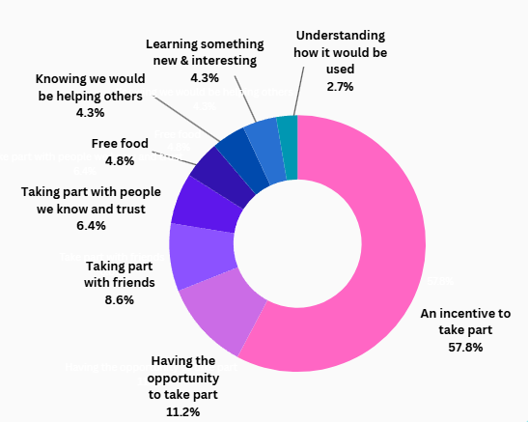



‘Incentives’ was said by almost 60% of young people!
80% of the young people that mentioned incentives specifically said ‘money’
It is important to note that young people struggled to understand what ‘taking part in health and care research’ actually meant. This was then an automatic barrier to them getting involved.

Slide 12



‘Social media’
was said more than 2x the next most popular answer of ‘School’

Slide 13
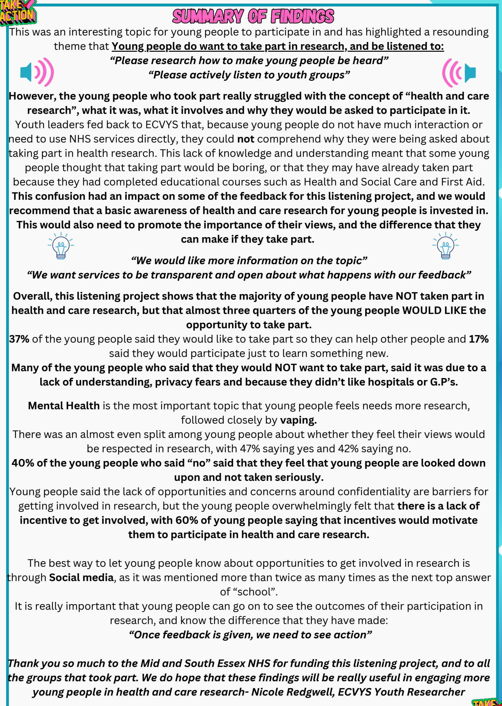

Young people struggled to understand what ‘taking part in health and care research’ meant and why they would be asked to participate in it.
More work needs to be done to clearly communicate what it is,
what it involves and in creating more opportunities specifically
aimed at young people.
Young people need to know that their views will be taken seriously and respected, and that just because they are young, does not mean that their views are any less important.
A good way to do this is to follow up and let them know what a difference their views have made.
The majority of young people HAVE NOT taken part in health and care research, but WOULD LIKE TO
Confidentiality and knowing how their views will be used is very important, as is a clear incentive to take part, such as money!
Mental health and vaping are issues for young people
that they would like to see more research on (and get involved with).
Social media would be the best way to let young people
know about any opportunities to take part in research opportunities.
This Photo by Unknown Author is licensed under CC BY

